Slide 1
BUSINESS PROCESS REENGINEERING
(PHASES 1 & 2)
by
Mustafa Shiraz Ahmed
LECTURE 5

Slide 2
Business Process Reengineering
Business Process Reengineering means not only change but dramatic change.
What constitutes dramatic change is the overhaul of organizational structures, management systems, employee responsibilities and performance measurements, incentive systems, skills development, and the use of information technology.

Slide 3
The Impact
Business Process Reengineering, (BPR) can potentially impact every aspect of how we conduct business today.
Change on this scale can cause results ranging from enviable success to complete failure.

Slide 4
Revolutionary
Successful BPR can result in enormous reductions in cost or cycle time.
It can also potentially create substantial improvements in quality, customer service, or other business objectives.
The promise of BPR is not empty -- it can actually produce revolutionary improvements for business operations

Slide 5
The Benefits
Reengineering can help an aggressive company to stay on top, or transform an organization on the verge of bankruptcy into an effective competitor.
The successes have spawned international interest, and major reengineering efforts are now being conducted around the world.

Slide 6
The Risk
On the other hand, BPR projects can fail to meet the inherently high expectations of reengineering.
Recent surveys estimate the percentage of BPR failures to be as high as 70%.

Slide 7
The Risk
Some organizations have put forth extensive BPR efforts only to achieve marginal, or even negligible, benefits.
Others have succeeded only in destroying the morale and momentum built up over the lifetime of the organization.
These failures indicate that reengineering involves a great deal of risk. Even so, many companies are willing to take that risk because the rewards can be astounding

Slide 8
The Reasons
Many unsuccessful BPR attempts may have been due to the confusion surrounding BPR, and how it should be performed.
Organizations were well aware that changes needed to be made, but did not know which areas to change or how to change them.

Slide 9
Management Concept
As a result, process reengineering is a management concept that has been formed by trial and error -- or in other words practical experience.
As more and more businesses reengineer their processes, knowledge of what caused the successes or failures is becoming apparent.

Slide 10
Emergence of BPR
In 1990 and again in 1993, some definitive works were put forth by Dr. Michael Hammer, James Champy, and Thomas Davenport.
Hammer, named by Business Week as one of the four preeminent management gurus of the 1990s, together with Champy, chairman of CSC Index, Inc., gathered information about organizations thriving in their respective industries, along with assorted management consulting experiences.

Slide 11
Emergence of BPR
They were asking the questions of, "What worked and why?" along with "What didn’t work and why not?"
They discovered that most of the companies that had succeeded in changing their processes had used a similar set of tools and tactics. They called this set of procedures Business Reengineering.

Slide 12
The Definition
According to Michael Hammer, Business Reengineering is the fundamental rethinking and radical redesign of business processes to achieve dramatic improvements in critical, contemporary measures of performance, such as cost, quality, service, and speed.

Slide 13
Process Innovation
Thomas Davenport also performed research in this area, asking similar questions, through his work at Ernst & Young’s Center for Information Technology and Strategy.
By examining companies that were redesigning processes, he gathered information on methods and practices which led to the successful implementation of what he called Process Innovation.

Slide 14
Redesigning
Although slightly different, both Business Reengineering and Process Innovation address the concept of redesigning how businesses perform strategic processes.
In fact, both approaches shared a number of core activities. Because processes were at the heart of these management philosophies, the term Business Process Reengineering, or BPR, was adopted to describe these efforts.

Slide 15
Redesigning
Since then, a myriad of books, articles, seminars, workshops, and computer tools have been developed by academicians,management consultants, and software developers to help organizations actually perform BPR.

Slide 16
Disagreement
Today, many organizations have acquired extensive experience in performing BPR.
Many of these experts are still not in agreement on every activity necessary for performing BPR; yet, the core activities have remained stable during the continuous debate.
The disagreements may be, in part, due to the uniqueness of each organization. Because organizations differ, the activities necessary to successfully perform BPR may also differ.

Slide 17
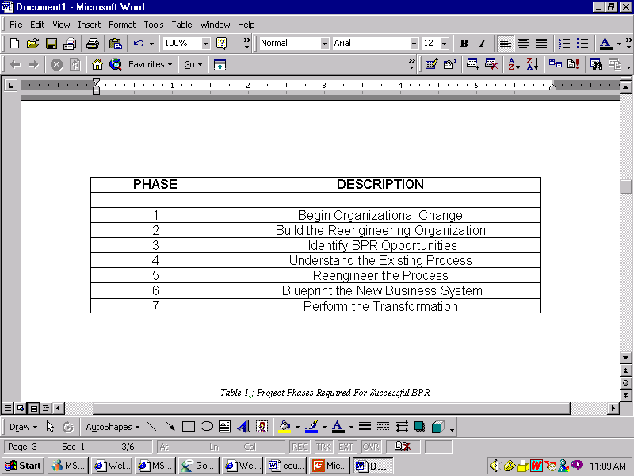
The Seven Phases

Slide 18
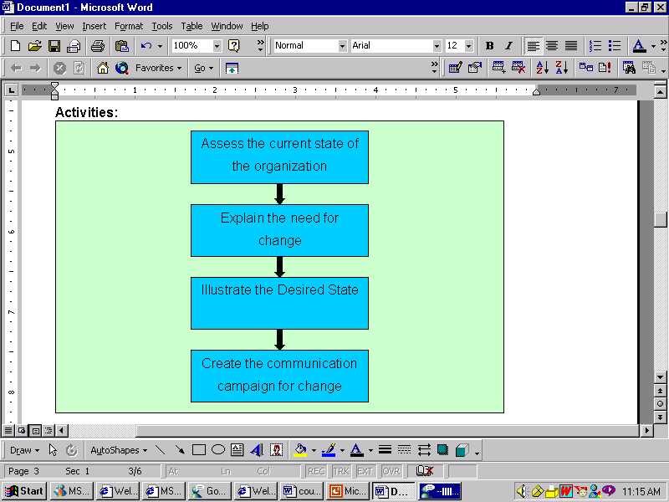
Begin Organizational Change

Slide 19
Begin Organizational Change
The first step is to take a long, hard look at how the organization operates.
The focus of this examination is on the operating procedures and the bottom-line results that are generated by them.
The purpose of performing the analysis is to determine whether dramatic change by doing BPR is really necessary.

Slide 20
Begin Organizational Change
It may be that only marginal change (the result of Continuous Process Improvements, Total Quality Management, and other similar programs) is needed -- which would expose the change initiative and the organization to much less risk.

Slide 21
Begin Organizational Change
Aspects of the business that need to be evaluated are:
  how things are currently done,
  what changes may be occurring,
  and what new circumstances exist in our business environment.
Next, a look at how certain operating procedures within the organization have caused or will cause irreparable damage to the company’s livelihood.

Slide 22
Begin Organizational Change
What is the source of the organization’s concern?
Maybe the demands of the marketplace are shifting.
Perhaps competitors have made significant advancements in products and services.
Regardless of the reasons, it should be clear whether or not the organization, in its current state, is able to meet the needs of the markets it serves.

Slide 23
Begin Organizational Change
The consequences of inaction should be identified and well understood.
In most cases, these consequences are the loss of jobs by shutting down portions of the business, or perhaps the entire business.
Finally, the proper future direction of the organization should be decided.
The future "vision" of how the business must operate will serve as a clear and concise guide with measurable goals for employees to focus on.

Slide 24
Begin Organizational Change
Because BPR can potentially require significant changes throughout an organization, it must begin with a communications campaign to educate all those who will be impacted by this change.
Communication to all levels of personnel must remain active from start to finish to keep everyone involved and working towards a common goal.

Slide 25
Begin Organizational Change
Without a common understanding about what is happening, confusion and uncertainty about the future can result in resistance strong enough to stop any reengineering effort.
BPR is most effective when everyone understands the need for change, and works together to tear down old business systems and build new ones.

Slide 26
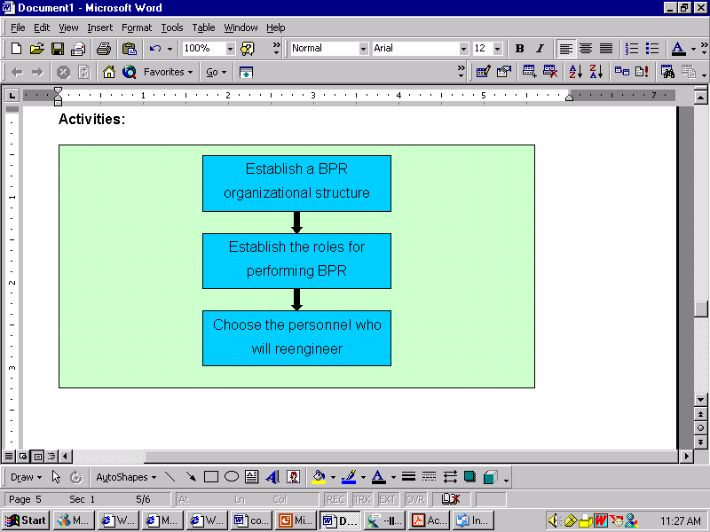
Build the Reengineering Organization

Slide 27
Build the Reengineering Organization
An infrastructure must be established to support reengineering efforts.
Although this phase consists of only a few tasks, it has a tremendous impact on the success of a BPR endeavor.

Slide 28
Build the Reengineering Organization
Who are the people that will be chartered to reengineer the business? What will their responsibilities be? Who will they report to?
These are the questions that must be answered as the reengineering staff is gathered together to communicate, motivate, persuade, educate, destroy, create, rebuild, and implement.

Slide 29
Build the Reengineering Organization
One of the most important members of the reengineering effort is the executive leader.
The leader must be a high-level executive who has the authority to make people listen, and the motivational power to make people follow.
Without the commitment of substantial time and effort from executive-level management, most BPR projects cannot overcome the internal forces against them and will never reach implementation.

Slide 30
Build the Reengineering Organization
A process owner is responsible for a specific process and the reengineering effort focused on it.
There should be a process owner for each high-level process being reengineered.
Allocating the responsibility of a process to a specific person ensures that someone is in charge of how that process performs.
Process owners are usually appointed by the executive leader.

Slide 31
Build the Reengineering Organization
The process owner convenes a reengineering team to actually reengineer his or her process.
The team dedicated to the reengineering of a specific process should be made up of current insiders, who perform the current process and are aware of its strengths and weaknesses, along with outsiders who can provide objective input to spark creative ideas for redesign.

Slide 32
Build the Reengineering Organization
The team should be small, usually five to ten people. Since they will be the ones who diagnose the existing process, and oversee the redesign and implementation, they should be credible in their respective areas.
This qualification plays an important role in reducing the resistance by company personnel to the new process.

Slide 33
Build the Reengineering Organization
In some BPR initiatives it is helpful to institute a steering committee. Especially in larger or multiple reengineering projects, a steering committee can control the chaos by developing an overall reengineering strategy and monitoring its progress.

Slide 34
Build the Reengineering Organization
Lastly, a reengineering specialist can be an invaluable addition to the overall effort.
A reengineering specialist can assist each of the reengineering teams by providing tools, techniques, and methods to help them with their reengineering tasks.

Slide 35
Build the Reengineering Organization
The impact of key members on a reengineering effort is often underestimated.
A study of BPR projects published in the Harvard Business Review listed "assigning average performers" as one of the four ways redesign efforts tend to fail.
The study showed companies were afraid of assigning their top performers because it could have impacted the performance of business units while reengineering was underway.

